Slide 1
Exercise 4

Slide 2
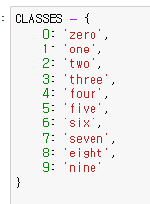
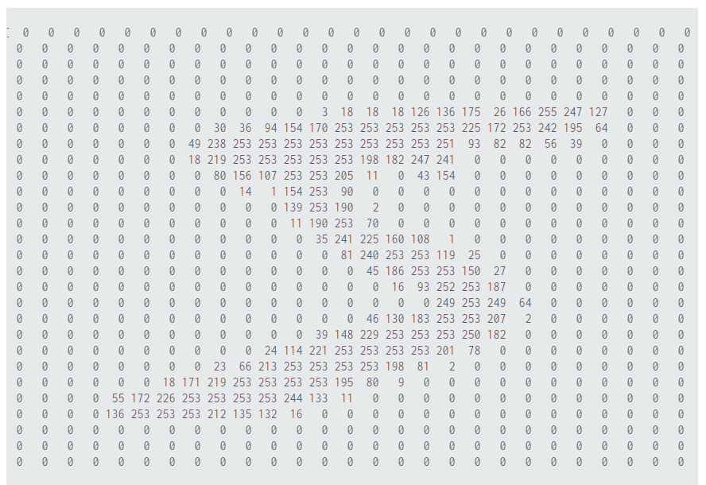
Image Classification
Mnist ( image , label)
Classifier

Slide 3
Coding 전에 생각해 볼 것
RECAP
입력 데이터 : image( C , H , W )
출력 데이터 : class number ( 10개의 class)
Optimizer: gradient descent method
Loss function: cross entropy
∑
f
∑
f
∑
f
.
.
.
.
.
.
.
.
.
∑
f
y
∑
f
∑
f
∑
f

Slide 4
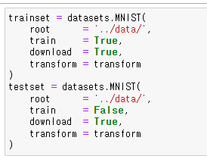
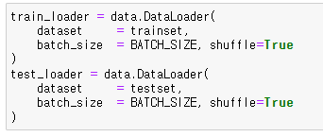
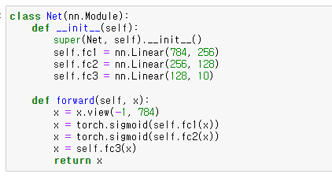
준비 단계 1
RECAP
입력 데이터
출력 데이터
Model

Slide 5
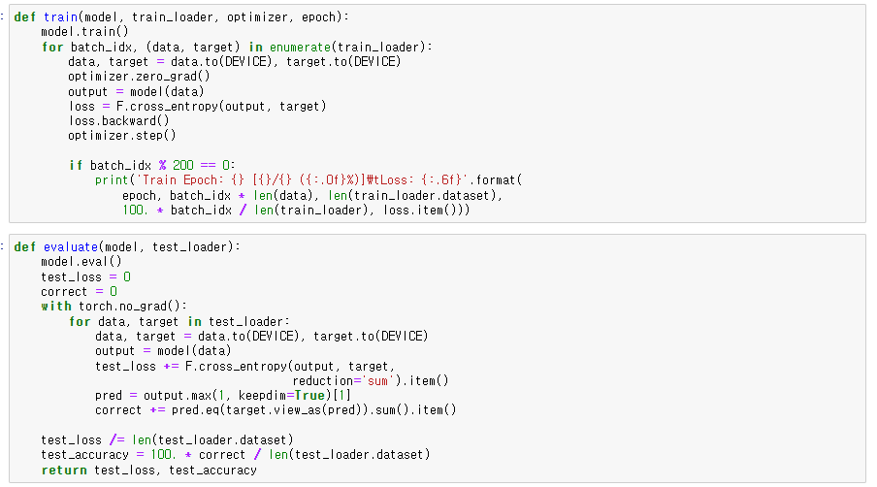
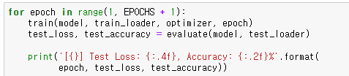
Exercise 3
RECAP

Slide 6

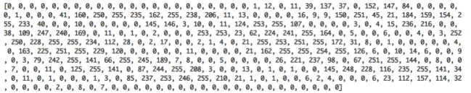
nn.Linear
RECAP
∑
f
∑
f
∑
f
.
.
.
.
.
.
.
.
.
∑
f
y
∑
f
∑
f
∑
f

Slide 7
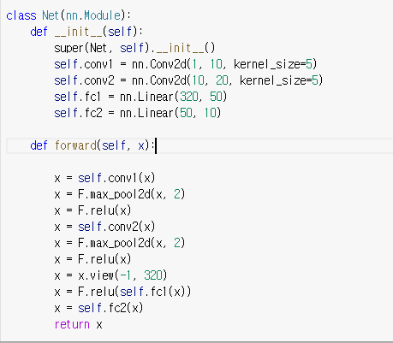
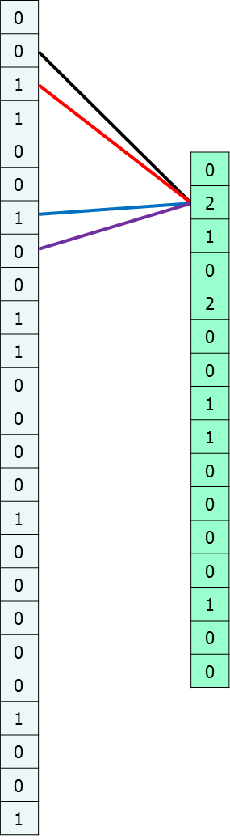
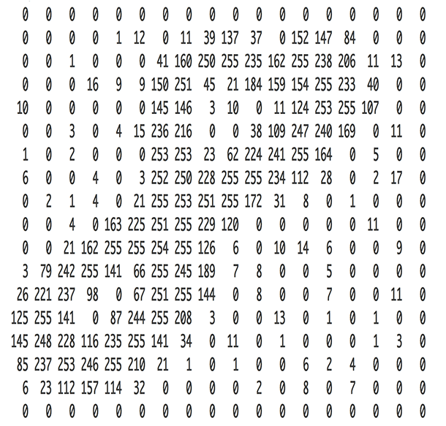
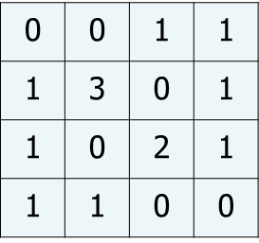
CNN
0.0125
-0.0664
0.0881
0.178
0.1551
-0.1078
0.0188
-0.2199
-0.1829
0.1543
Convolution
Pooling
Linear

Slide 8
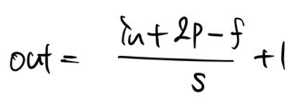
feature map size
Convolution
Pooling
Convolution
Pooling
kernel
kernel
5*5*1 10개
5*5*10 20개
[64, 1, 28, 28]
[64, 10, 24, 24]
[64, 10, 12, 12]
[64, 20, 8, 8]
[64, 20, 4, 4]

Slide 9
feature map size
0.0125
-0.0664
0.0881
0.178
0.1551
-0.1078
0.0188
-0.2199
-0.1829
0.1543
[64, 20, 4, 4]
[64, 320]
[64, 50]
[64, 10]

Slide 10
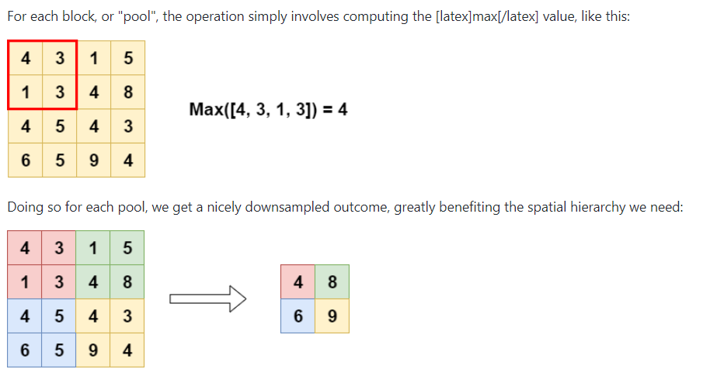
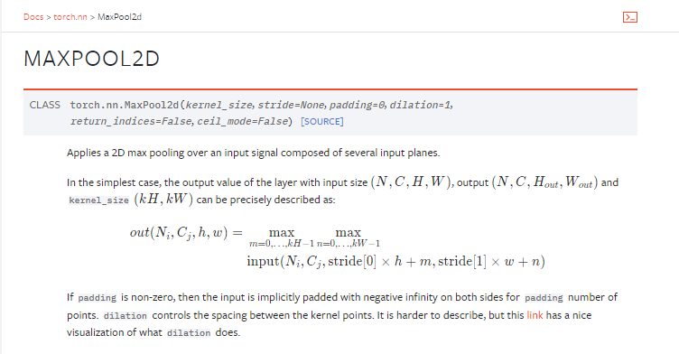
MaxPool2d
https://github.com/christianversloot/machine-learning-articles/blob/main/what-are-max-pooling-average-pooling-global-max-pooling-and-global-average-pooling.md

Slide 11
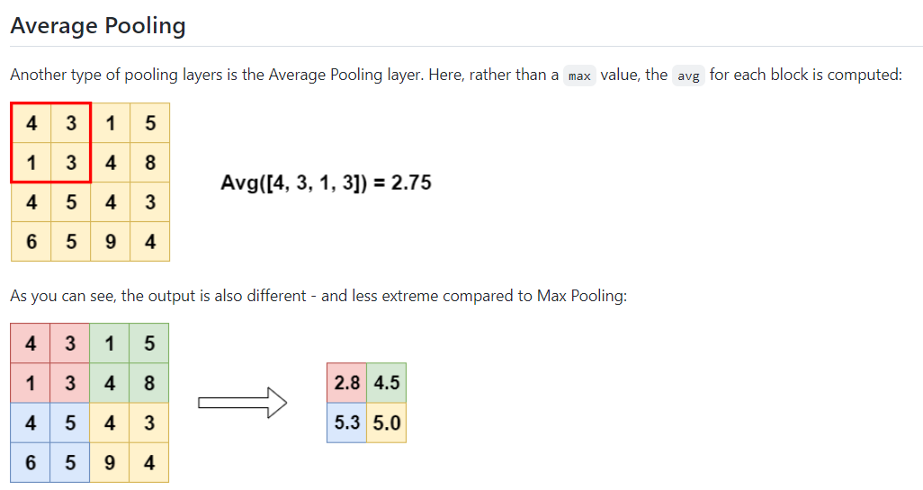
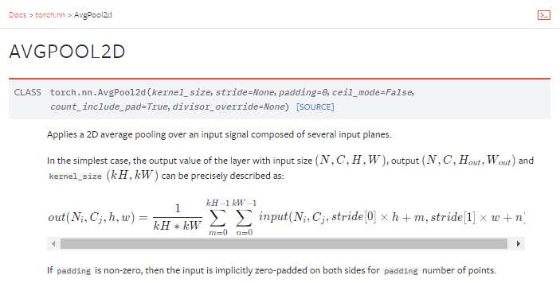
AvgPool2d

Slide 12
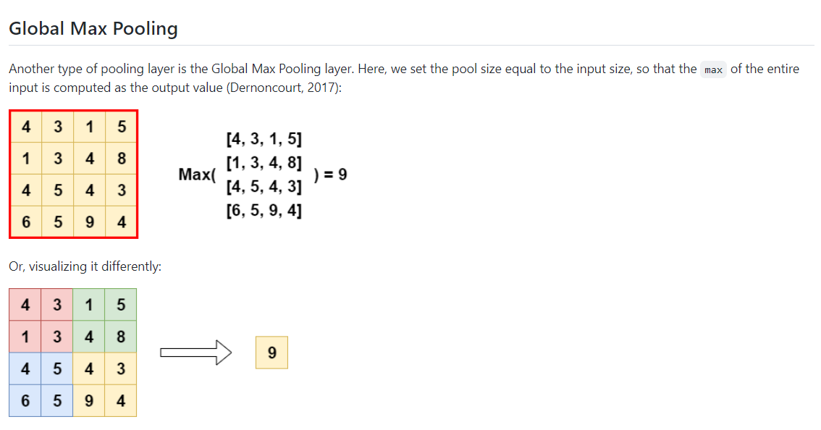
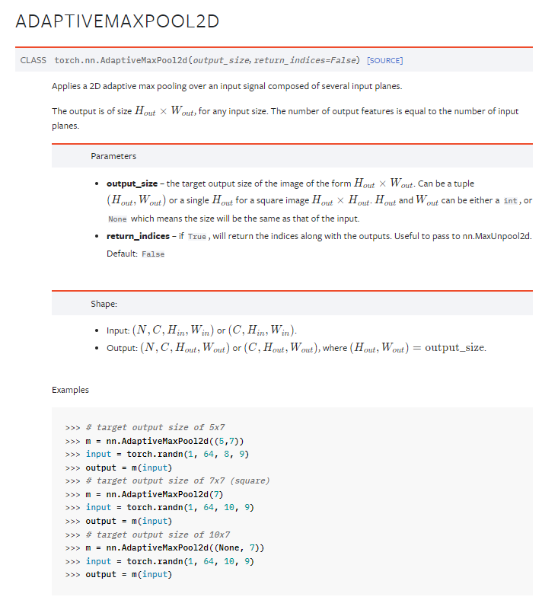
Global Max Pooling

Slide 13
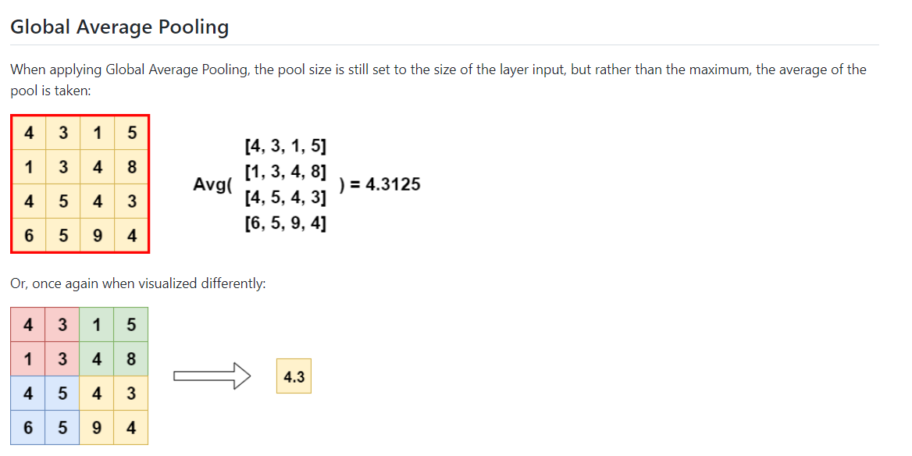
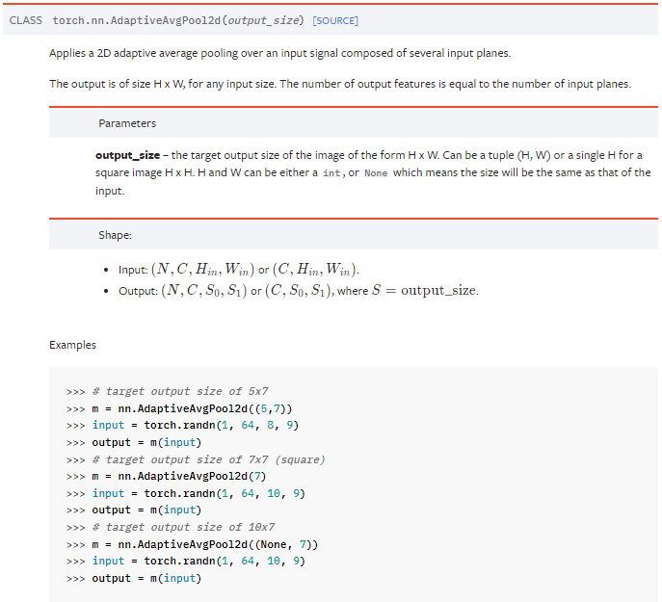
Global Avg Pooling

Slide 14
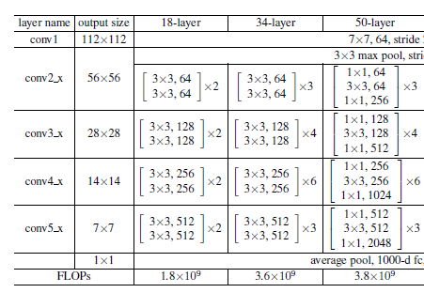
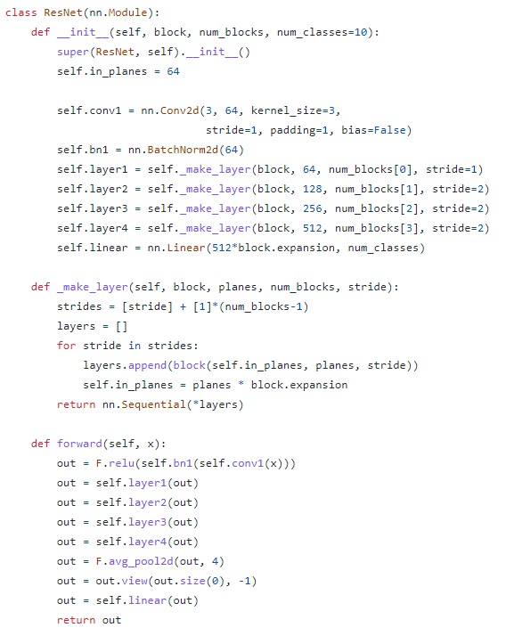
ResNet
1
2

Slide 15
Question and Answer

